Slide 1


Title : Hydrology and Biodiversity of Agumbe
Bhuvan.V standard:9th
12/1/2022
LAKE 2022: Conservation of wetlands: ecosystem-based adaptation of climate change, December 28-30, 2022
1

Slide 2
Introduction
Agumbe is a village situated in the Thirthahalli taluka of Shivamoga district, Karnataka.
Agumbe is a high-altitude village in the southwest Indian state of Karnataka.
Surrounded by the Western Ghats mountains and lush rainforest.
The village covers an area of 3 square kilometers.

Slide 3
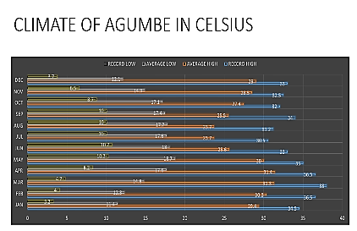
Climate
Agumbe lies in a rain forest region with tropical climate, warm and humid.
Maximum temperature here is varied between 24.4 degree Celsius and 31.5 degree Celsius
Minimum temperature varies between 16.2 degree Celsius and 21.4 degree Celsius
April is the hottest month and the December is the coolest.

Slide 4
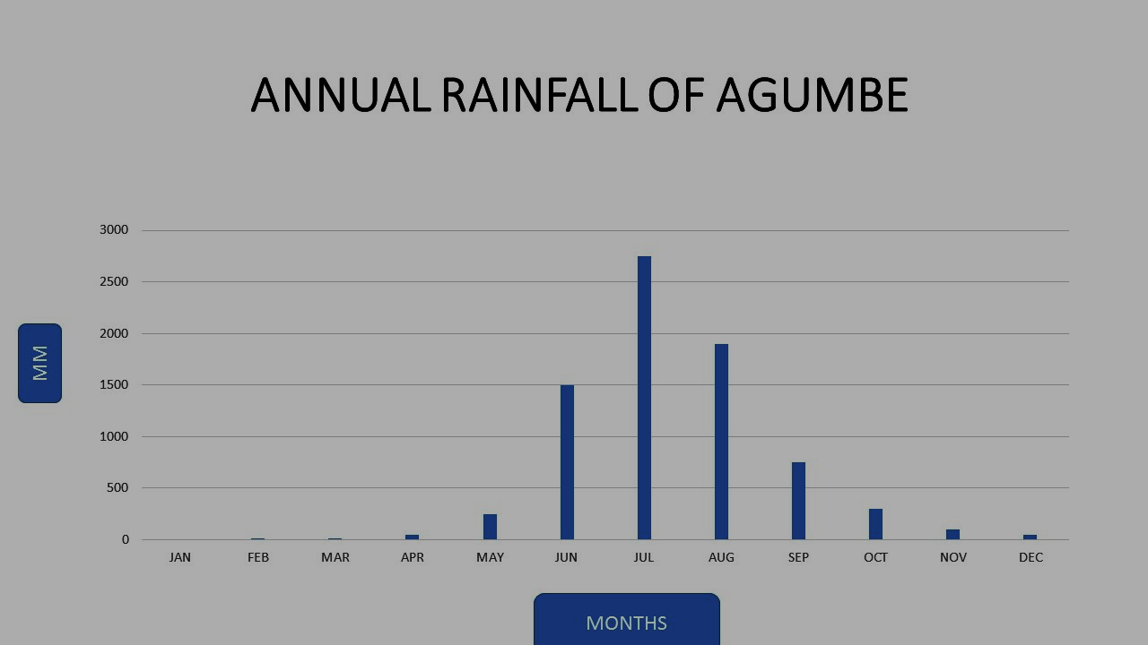
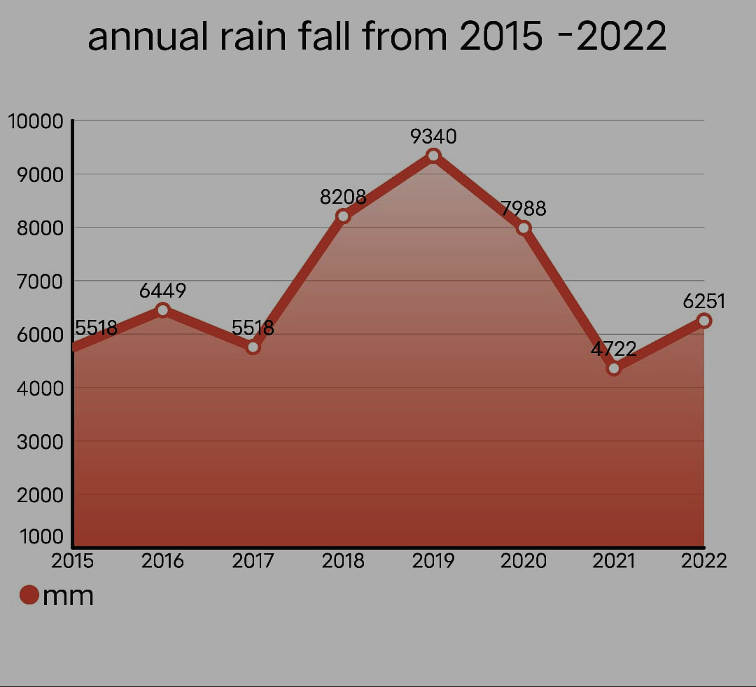
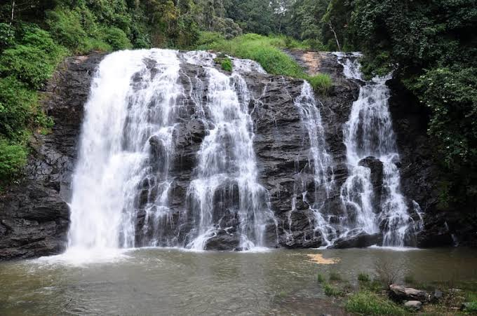
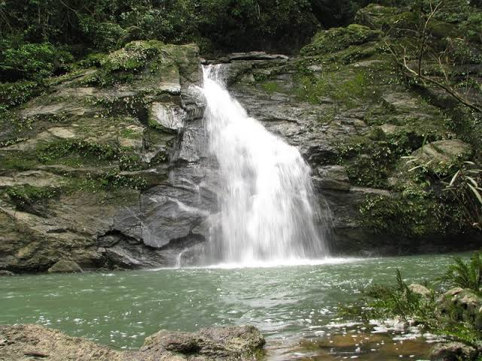
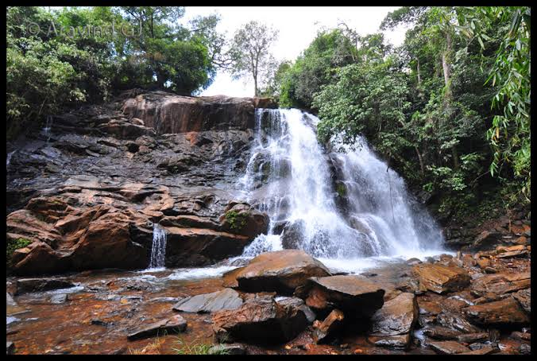
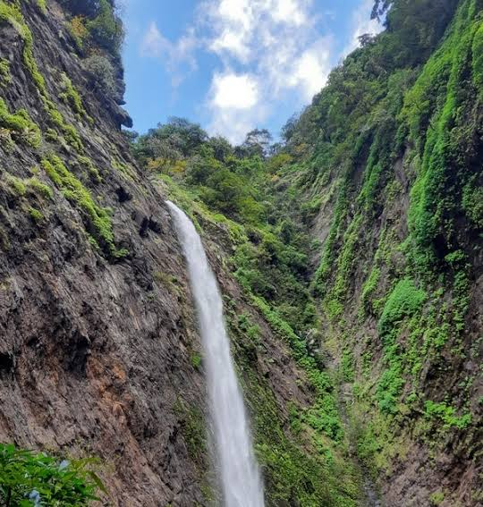
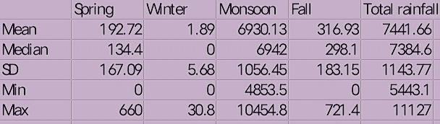
Hydrology

Slide 5
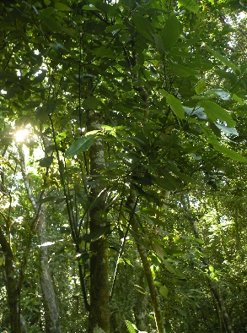
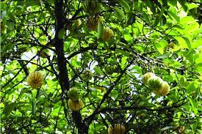
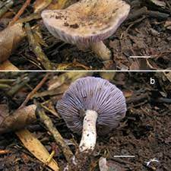
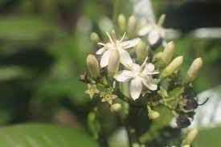
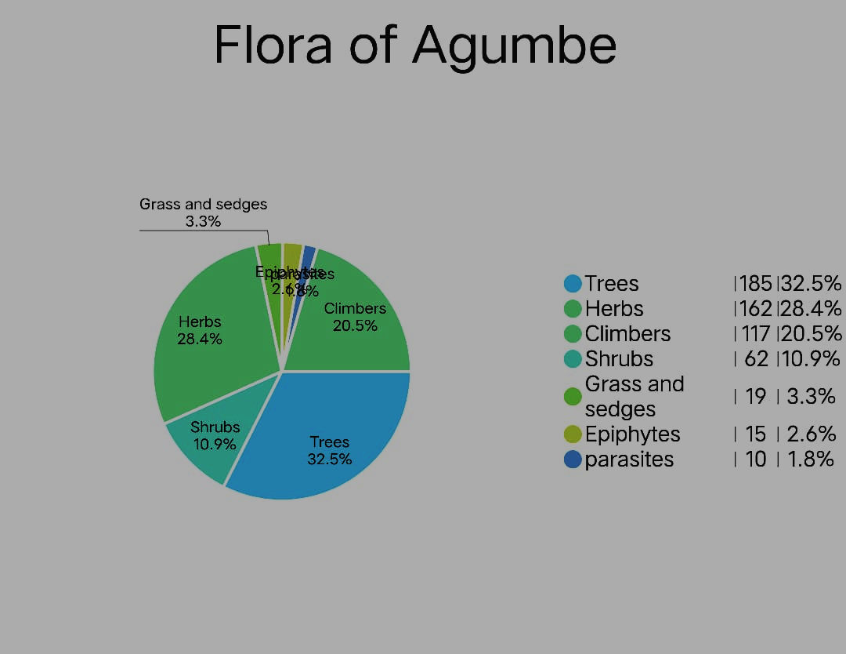
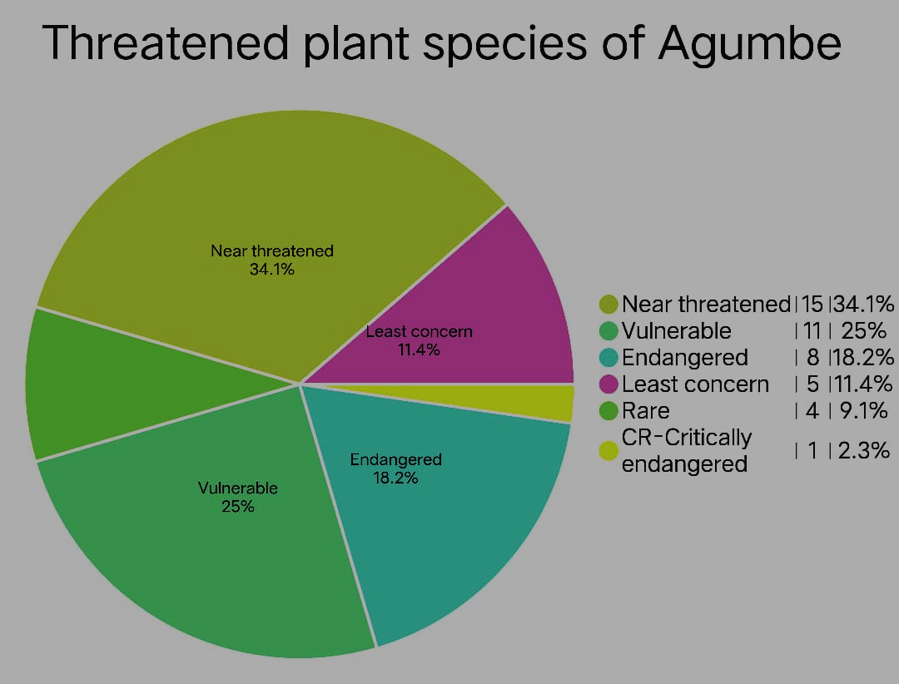
Flora
Dipterocarpus indicus
Dysoxylum malabaricum
Garcinia indica
Garcinia gummi gutta
Vateria indicus
Andenia hondala
Celastrus panicultus
Tarenna agumbensis
Myristica dactyloides
Aristolochia agumbensis
Persea macrantha
Hygroaster agumbensis

Slide 6
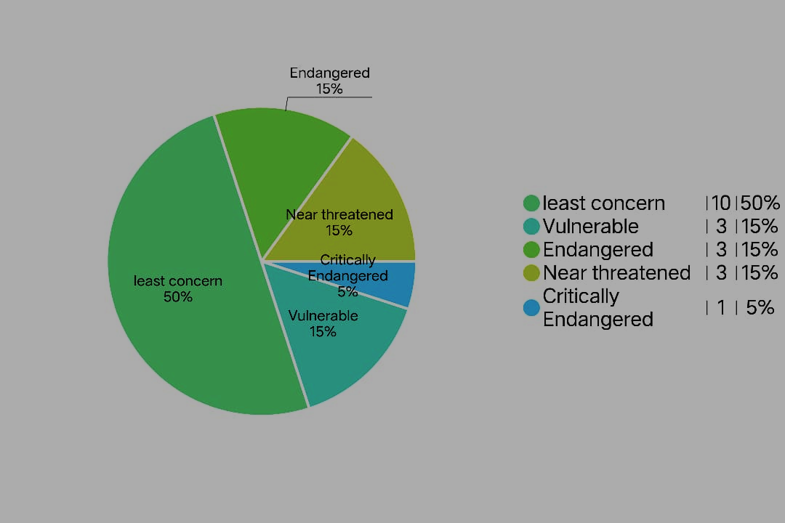
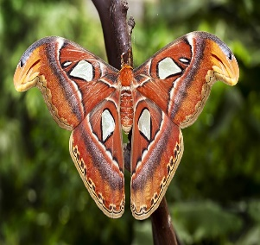
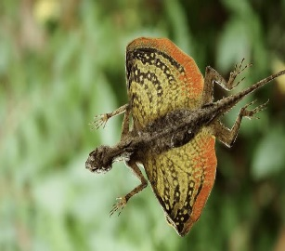
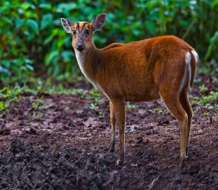
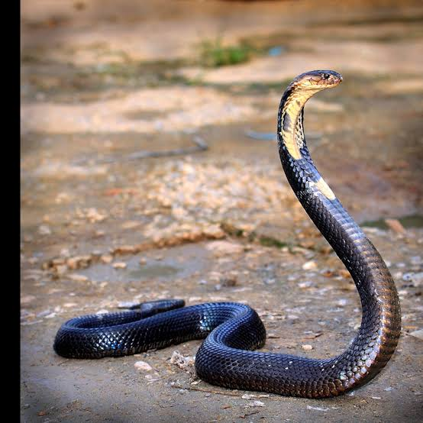
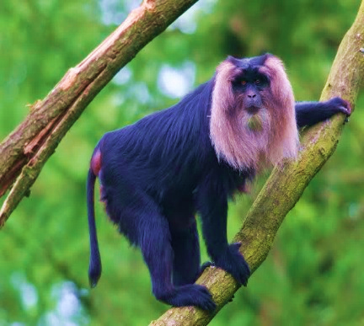
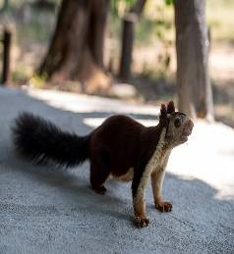
Fauna
Lion tailed macaque
Barking deer
Cane turtle
Flying lizard
The Indian bison
King cobra
Atlas moth
Selenops
Drosophila agumbensis
Gemnoconchus agumbensis

Slide 7
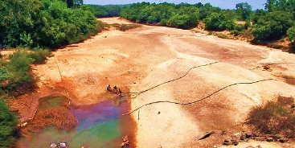
Water crises
Agumbe is known as cherrapunji of south .
Agumbe has gone dry due to deforestation excessive sand mining and prevailing drought conditions.
The delay of April showers has led to the perennial going dry.
Solutions
Rain water harvesting
Adaptation of water absorbing plants
Reduce of deforestation

Slide 8
References
https://en.wikivoyage.org › wiki › Agumbe
https://tourism.webindia123.com › tourism › Agumbe
https://www.weathercrave.com/weather
https://www.thebetterindia.com/6003/tbi-wildlife-in-search-of-the-king-at-agumbe/
India.comhttps://www.india.com › Travel › Destinations

Slide 9
Acknowledgment
I thank Vagdevi Vilas Institutions for giving an opportunity to be a part of IISC (Biennial Lake Symposium)

Slide 10
Thank You

